Slide 1
Virtualization

Slide 2
Why we need virtualization ?
Increased performance and computing capacity
Underutilized hardware and software resources
Lack of space: Big companies vs enterprises
Greening initiatives
Rise of Administrative costs

Slide 3
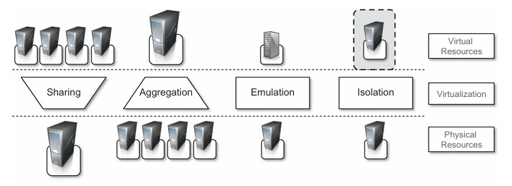
Characteristics of Virtualized environments
Increased Security
Managed Execution
Portability: Virtual image

Slide 4
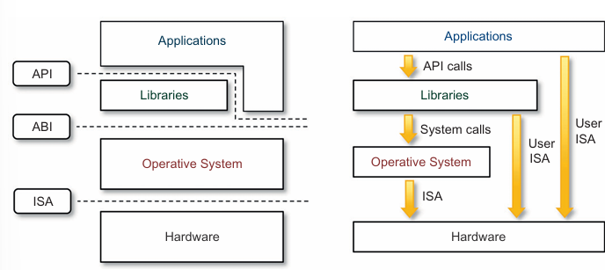
Machine Reference Model
Different execution environment at computing levels
OS developer (System ISA), application developer (user ISA)
ABI: low level data types, format for executable programs
High-level abstraction:
nonprivileged
Privileged
Behavior sensitive: I/O
Control sensitive : cpu registers

Slide 5
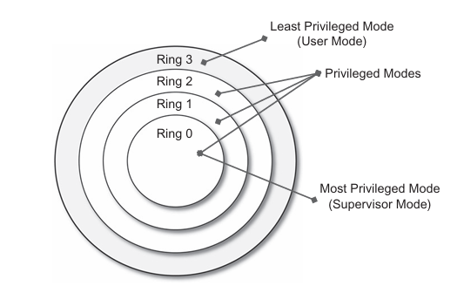
Security rings and privilege modes.
User Mode
Supervisory mode: execution mode
Hypervisor mode: above supervisory mode
Managing traps:
ISA 17 sensitive instruction for user mode
How guest os sensitive instructions are handled while it runs in user mode?

Slide 6
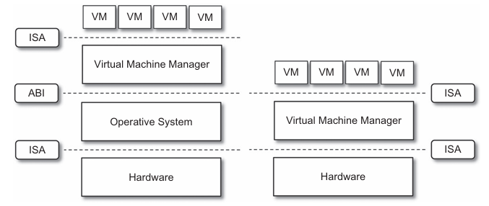
Hardware level virtualization/system virtualization
Hypervisor ?
Type –I
VMM:
Directly runs on top of hardware(Native VM)
Type-II
Requires support of OS for virtualization services (Hosted VM)

Slide 7
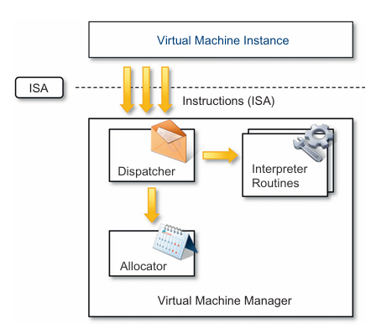
Virtual Machine Manager: VMM
Dispatcher : entry point,( invocator)
Allocator : manage resource allocation.
Interpreter
Efficient VMM must satisfy the criteria of three properties (Golgberg & Popek):
Equivalence :A guest running under the control of a virtual machine manager should exhibit the same behavior as when it is executed directly on the physical host.
Resource Control: The virtual machine manager should be in complete control of virtualized resources.
Efficiency: A statistically dominant fraction of the machine instructions should be executed without intervention from the virtual machine manager.

Slide 8
Hardware virtualization techniques
Full virtualization: Full virtualization refers to the ability to run a program, most likely an operating system, directly on top of a virtual machine and without any modification, as though it were run on the raw hardware
Paravirtualization: This is a not-transparent virtualization solution that allows thin VMM.
Performance critical operation for host
Open source and academic environment
Partial Virtualization: Partial virtualization provides a partial emulation of the underlying hardware, thus not allowing the complete execution of the guest operating system in complete isolation.

Slide 9
Operating system Level Virtualization
For concurrent execution
No VMM or Hypervisor
Virtualization within single OS, kernel allowing multiple user space instances.
User spaces includes: isolated view of file system, separate IP, configuration and access to devices
Direct call to OS system call, no emulation, no overhead unlike hardware virtualization
Programming Language-level virtualization: bytecode program
For deployment
Platform/OS portability

Slide 10
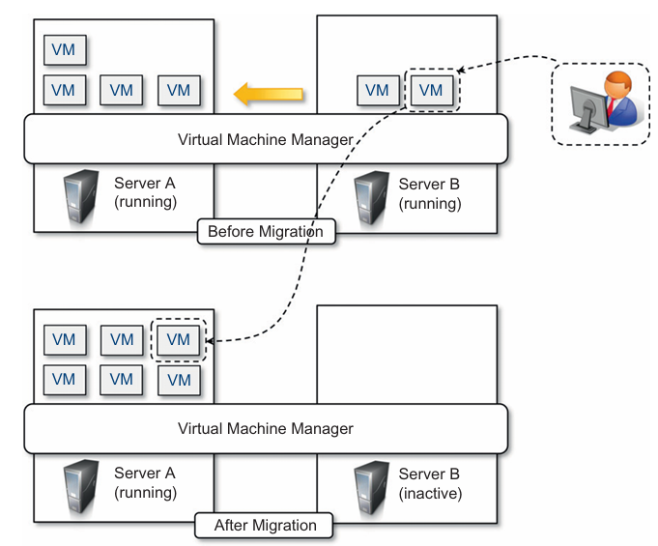
Virtualization and Cloud Computing
Mostly for computing and storage environment not for network.
Hardware virtualization (IaaS)
Programming language virtualization (PaaS)
Server Consolidation
Virtual machine migration
Live migration

Slide 11
Advantage and disadvantages
A virtual execution environment can be configured as a sandbox, thus preventing any harmful operation to cross the borders of the virtual host.
Resource partitioning is simplified providing finetuning of resources as well
Overhead by the following activities:
Maintaining the status of virtual processor s
Support of privileged instructions (trap and simulate privileged instructions)
Support of paging within VM
Console functions

Slide 12
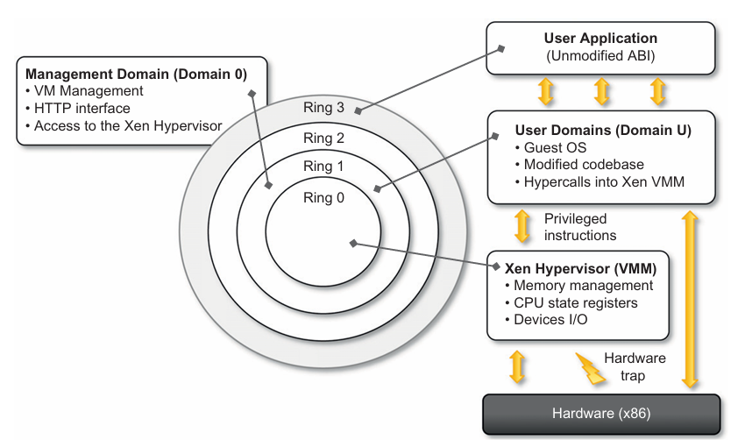
Examples: Xen -paravirtualization
Paravirtualization
Special Domain: Domain 0
First loaded
VM created and configured with http
Domain U: Ring 1
Paravirtualization needs the operating systems codebase to be modified, and hence not all operating system can be used as guest in a Xen based environment

Slide 13
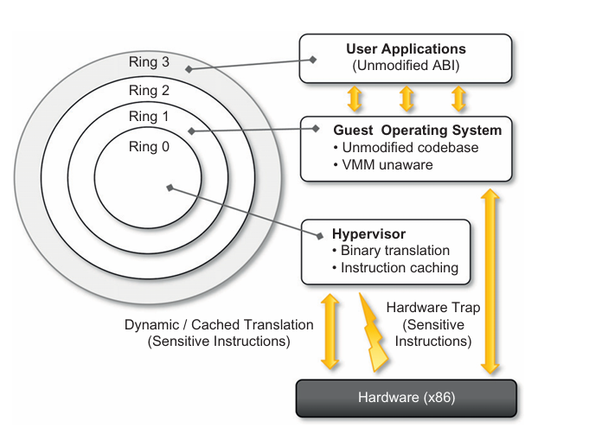
Vmware: full virtualization
Full virtualization
Type I : Server
Type II: Desktop
Direct execution for non privileged
Binary translation (sensitive instructions)
Memory Management issue.

Slide 14
Other types of Virtualization
Storage
Network
Desktop
Application server

Slide 15
Hostel Task
[PDF] A Survey of Virtualization Technologies: Towards a New Taxonomic Proposal | Semantic Scholar

